Slide 1
Cardiovascular system
Therapeutic procedures

Slide 2
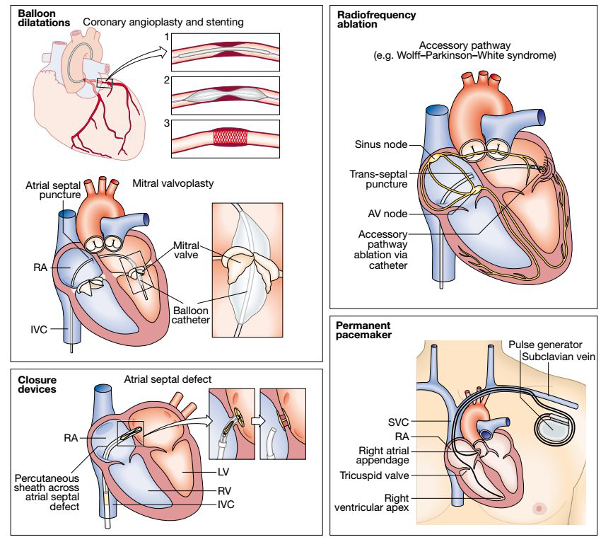

Slide 3
Catheters can be passed into the arterial circulation with X-ray guidance to permit balloon dilatation and/or stenting of diseased arteries.
Percutaneous coronary intervention (PCI) involves placement of a balloon catheter into one of the coronary arteries via a guide catheter, which is engaged in the coronary ostium.

Slide 4
This allows balloon angioplasty and coronary stenting.
This technique can also be used to treat stenoses in larger arteries, such as aortic coarctation.
Balloon valvuloplasty is sometimes used to treat mitral or pulmonary valve stenosis.

Slide 5
Patients with congenital heart defects, such as atrial septal defect and patent ductus arteriosus, can have these closed by devices delivered to the heart via a catheter.
Pacemakers are implanted to correct bradycardias or AV block.

Slide 6
Implantable cardiac defibrillators have similar capabilities to pacemakers and, in addition, can deliver an internal shock to defibrillate the heart if a life-threatening rhythm such as ventricular fibrillation occurs.

Slide 7
Cardiac resynchronisation therapy or biventricular pacemakers can improve cardiac function in some patients with heart failure.
Recurrent arrhythmias can be treated by catheter ablation.

Slide 8
Electrode catheters are placed in the heart and can locate re-entry pathways or automatic foci which cause tachycardias.
Radiofrequency current is passed through the catheter tip to heat the tissues and cauterise the culprit tissue.

